Slide 1
Budget Basics & MSU Funding Sources
Financial Development Certificate
FD101
April 17, 2019

Slide 2
Agenda
Banner Fund Type Descriptions
Budget Cycle
Budgeting and Adjusting Budgets
Current Unrestricted & Other Fund Types
Grant Funds
Reviewing budgets & budget-to-actual in Banner
CatBooks budgeting
Moving money across the University
Moving money from Foundation

Slide 3
Banner Fund Types
Current Unrestricted (General Operating) (Index starts with 40xxxx, 41xxxx, 4Axxxx, 4Rxxxx, 4Sxxxx) and Fund 411201
Restricted (42xxxx, 4Wxxxx)
Designated (43xxxx)
Auxiliary (44xxxx)
Plant (Index starts with 45xxxx,46xxxx) and Fund 47xxxx and 48xxxx
Other funds – Agency, Endowment, Loan, Debt

Slide 4
Current Unrestricted (General Operating)
Revenue from State Appropriations and Tuition
State Appropriations
Legislature to the Montana University System
Board of Regents to each of the MUS campuses
Tuition Rates are set by Board of Regents in coordination with campuses

Slide 5
Current Unrestricted (cont’d) (General Operating)
Revenue is collected centrally rather than in individual department indexes
Departments receive a BUDGET allocation
Deposits to income should never be made to these funds
To be spent for the purpose of EDUCATING students or the direct support of that process

Slide 6
Restricted
Grants, Gifts/Donations, Scholarships, Foundation reimbursement accounts
Specific sources of income & account codes
Office of Sponsored Programs will provide account codes for grants, for 423xxx indexes the account code is 53950
Comes to department as either direct income (donors) or reimbursements (grants & Foundation)
To be spent for the purpose specified by funding source

Slide 7
Designated
Sales & service, indirect costs (IDC), some student course fees, recharge centers, field trips, conferences
Varied sources of income & account codes
includes income account codes – 53350-recharge, 53360-IDC, 53631-educ sales
Revenue is generated as either direct income (customers) or recharge income (University Information Technology, Facility Services)
Spending is generally not restricted, can be used for any departmental purpose. Exception is student course fees.
Activity may generate UBI (Unrelated Business Income) and must be reviewed annually

Slide 8
Auxiliary
On campus sales & service activities, student services
Income from residence halls, food services (room & board), parking

Slide 9
Plant
New construction, Repair & Replacement (R&R), Capital equipment, Capital Software
Income is usually a transfer in from some other fund type

Slide 10
Budget Cycle
Fiscal year is from July 1-June 30th
Fall
Executives make budget requests for upcoming year based on Planning Council’s set of strategic priorities
Spring
March: Position budgets corrected
May: Current Unrestricted Allocations
May to June: Departments enter budgets
July: Budgets loaded for new year

Slide 11
Budgeting Guidelines
Current Unrestricted
Receive budget allocation and all dollars need to be budgeted to match that allocation
Other Fund Types
Budget what you believe you will receive in revenue and what you believe you will expend
Grants are not budgeted through this process

Slide 12
Budget Entry Process
Budgets completed at index level
Position budgets are pre-loaded into Labor Plan files in MSU Budget by the Budget Office
Operations budgets are completed in Budget by Index files in MSU Budget
Limited licenses so this is now being completed primarily at the college/unit

Slide 13
Office of Sponsored Programs Budgets
OSP manages and provides general oversight for all budget functions related to sponsored programs or any activity, research or otherwise, that is funded by an external source such as a federal, state, or private organization.
May not follow State Fiscal Year and can be multi year
May be subjected to additional restrictions
Vary by funding agency
Different budget categories
Different formats

Slide 14
Office of Sponsored Programs
If you have a question regarding funds handled through OSP, please contact your department’s fiscal manager (FM).
OSP main line: 994-2381
Website: http://www.montana.edu/research/osp/

Slide 15
Adjustments to Your Budget
After your original budget has been entered it is loaded into Banner
You can make adjustment to your budget throughout the year
There are 2 types of adjustments
Base Adjustments (positions are always base)
One Time Only adjustments

Slide 16
Budget Adjustments
Must be done within the same fund types
Processed in MSU Budget
Each fund type must balance to zero
If making a base adjustment to a permanent personnel account code (i.e. 61123, 61124, etc.) this must be done through a position adjustment

Slide 17
Budget Adjustments, Cont’d
Base Budget Adjustments (BD02)
Permanent changes to your base budget
For example, if you decrease your base budget by $5,000 it will continue to be $5,000 less unless another base adjustment is made
Position budgets should reflect the rate of pay of the current incumbent

Slide 18
Budget by Position Report

Slide 19
Budget Adjustments, Cont’d
One-Time-Only (OTO) Adjustments (BD04)
Happen on a one-time only basis within a specific fiscal year
For example, if a commitment is made by the Provost for $5,000 to support a project, your budget will increase only for the fiscal year in which the adjustment is made
Reflected in the Revised Budget column on the Operating Ledger Summary

Slide 20
Budget Adjustment Example
Base Budget at the beginning of FY19
$12,000
Base Adjustment is made for $2,000
New Budget = $14,000
One-Time Adjustment made for $10,000
Budget = $24,000 for FY19 only
Beginning Budget in FY20
$14,000

Slide 21
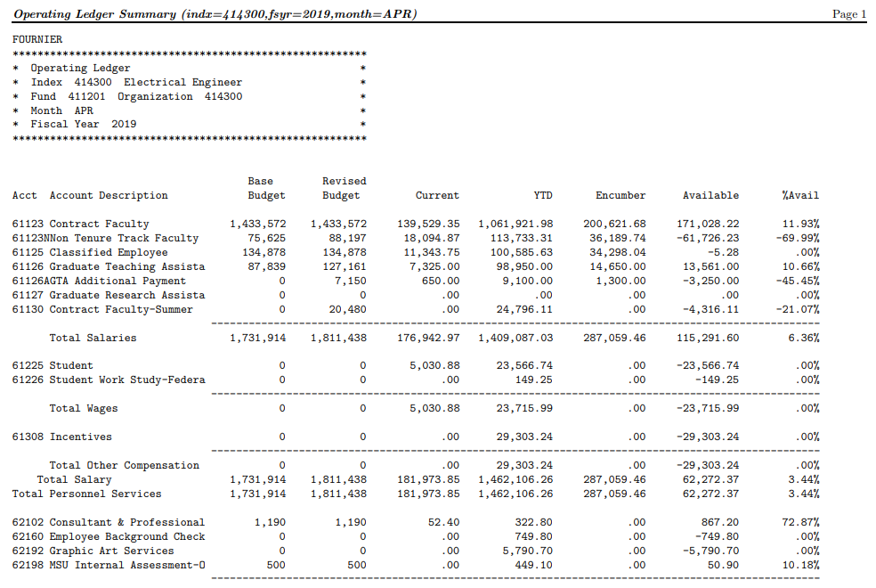

Slide 22
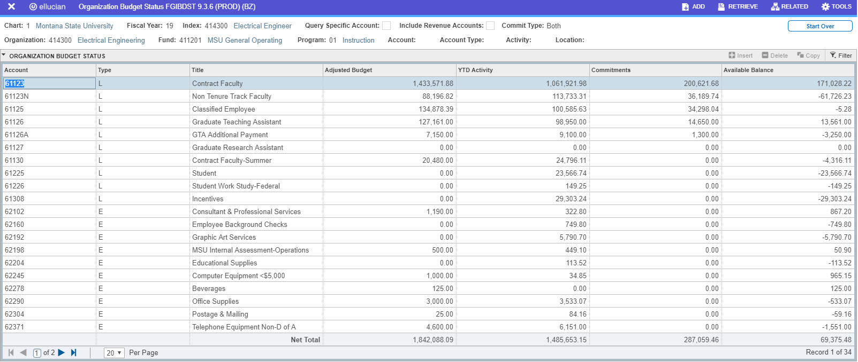
Available Balance – Current Unrestricted Index FGIBDST (only has current year information)
Uncheck include revenue from first screen
For General Operating indexes this represents the amount left to be spent for the fiscal year. Balance = Budget-(YTD+Commitments)

Slide 23
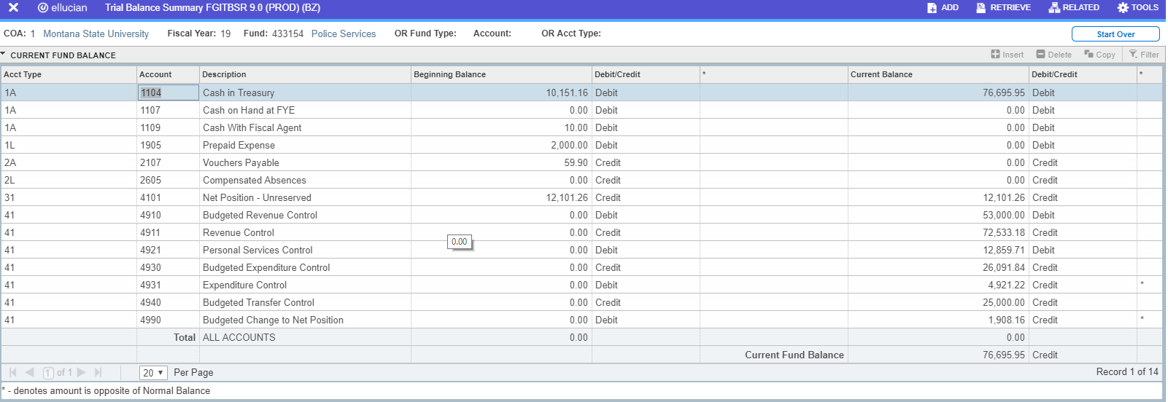
Fund Balance / Available Cash – Other Funds FGITBSR (includes prior year fund balance)

Slide 24
Budgeting in CatBooks
General Operating (Unrestricted) Funds
Once budget allocations have been entered into Banner, you can “Seed” your general operating budgets in CatBooks
Go to CatBooks Menu>Data Entry>Index and select the index from the drop down menu
Select Edit
Select Seed Budget for FYXXXX

Slide 25
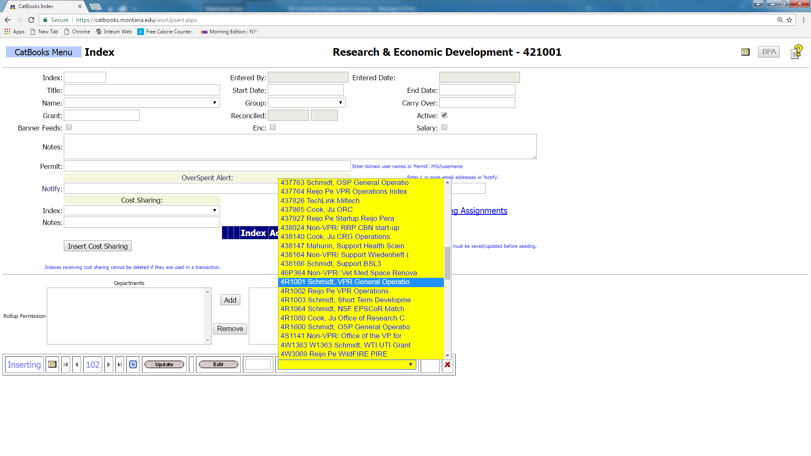

Slide 26
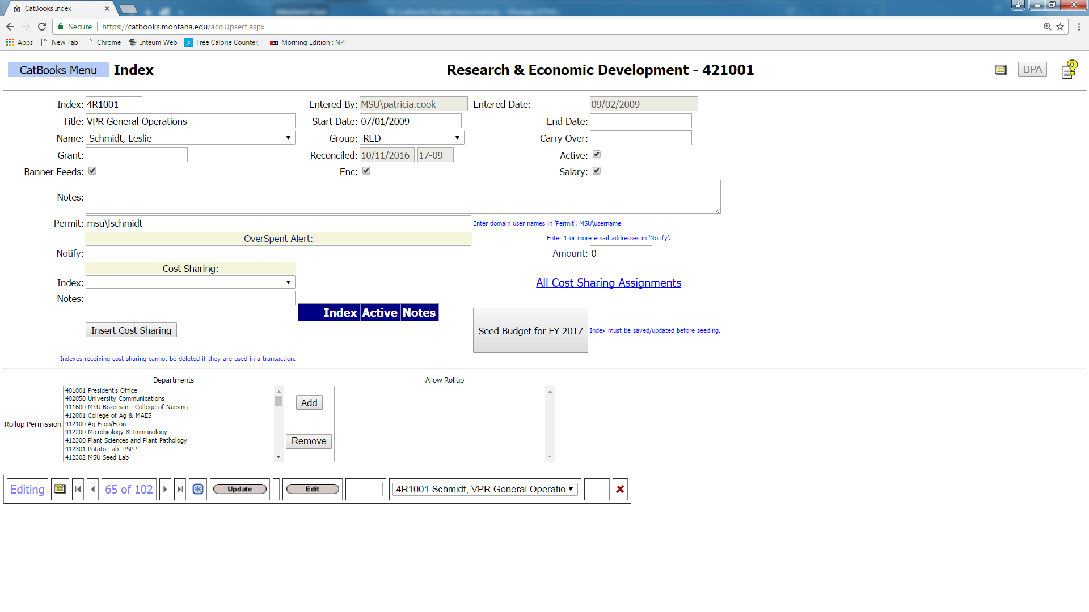

Slide 27
Budgeting in CatBooks
Seeding your budget imports budget entries (BD01 etc.) from Banner into CatBooks
Only do this once for each index. Seeding your budget more than once will duplicate the budget entries in CatBooks.
Normally done at the beginning of the fiscal year for base budget allocations.

Slide 28
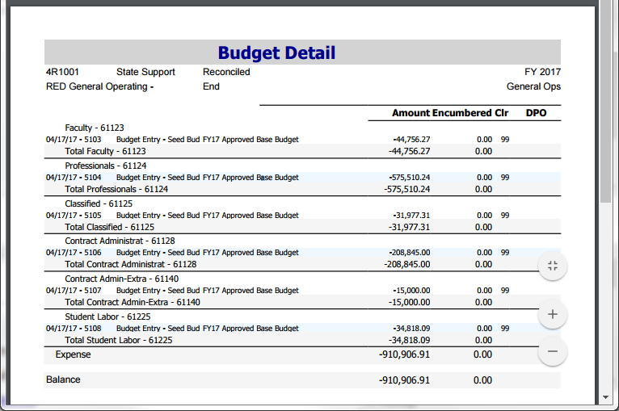
Should match your Banner budget.

Slide 29
Budgeting in CatBooks
Budget adjustments/transfers are not normally seeded in CatBooks but are entered as a transactions with a 99 in the clear month field.

Slide 30
Budgeting in CatBooks
Grant (Restricted) Funds
You can Seed the beginning Banner budget into CatBooks for a new grant.
Never Seed grant incremental budgets or budget modifications or it will double (or triple, or quadruple) your CatBooks budget.
Incremental budgets and modifications are entered as transactions with 99 in the clear month field.

Slide 31
Budgeting in CatBooks
CatBooks has a function used for grants that will carry forward budgets and ITD expenditure activity from one FY to the next.
This is done at the beginning of an FY after the prior FY has been reconciled.
Go to CatBooks Menu>Tools>Carry Over.
Read and follow the instructions carefully.
Select Run Carryover when you’re ready.

Slide 32
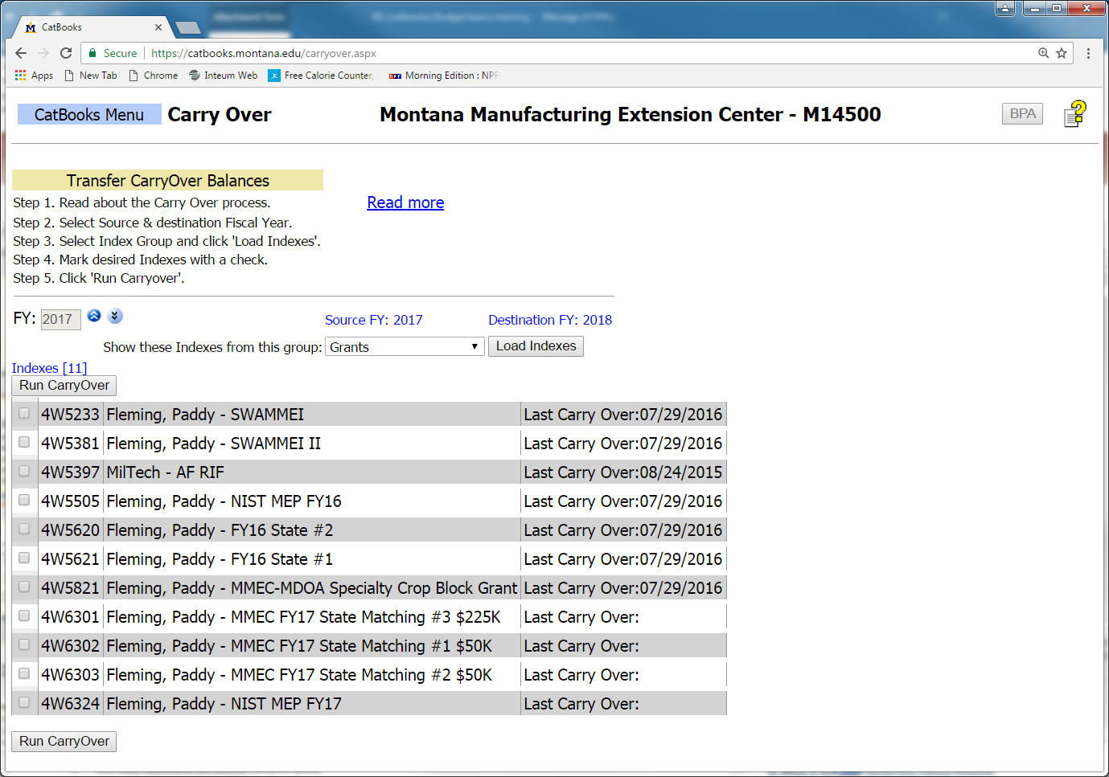

Slide 33
Budgeting in CatBooks
Designated Funds
You can Seed the Banner budget into CatBooks for a designated fund like a General Operating Fund, but it’s rarely done.
More commonly, departments enter their beginning cash as the budget.
Done by entering a transaction with a clear month of 99.

Slide 34
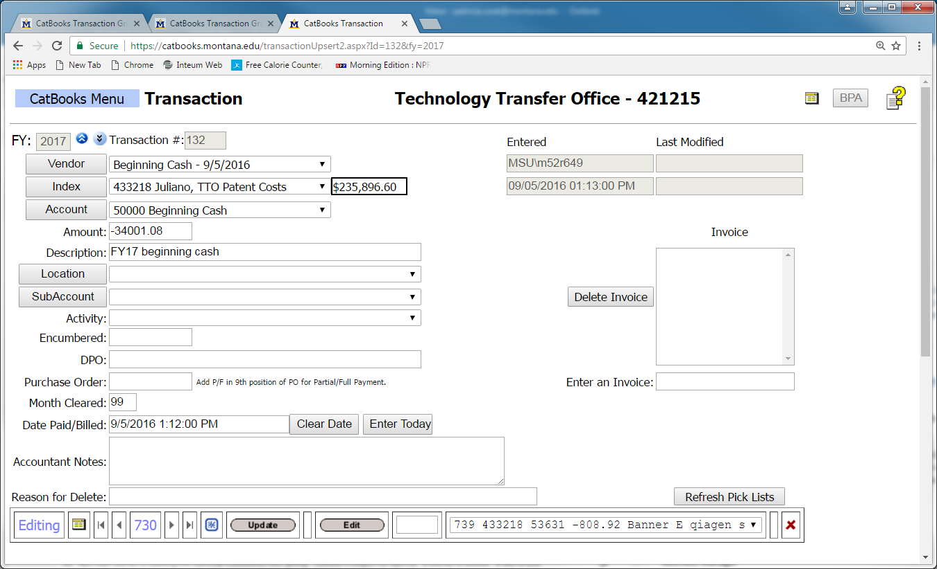

Slide 35
Moving $ between Fund Types
General Fund
General Fund
Via budget adjustment (Base or OTO)
General Fund
Other Fund Types
Restricted Gift Fund
Foundation Funds
Via Foundation disbursement voucher
Other Donors
Via cash deposit
Designated / Auxiliary Funds
General Fund
Via BPA
Designated / Auxiliary / Restricted Gift Fund
Via BPA or (infrequently as a cash transfer)

Slide 36
Moving $ between Fund Types
Moving budget from general fund to other fund type
This is more like a cash transaction
Use a BPA to “pay” the index. This is how we handle catering bills
Deposit money into general fund
This is a big “no no”
Needs to be deposited in another fund type

Slide 37
Moving $ with a JRC
JRC = Journal Recharge
For example, UIT buys a computer for a department and ‘resells’ it. They receive recharge income (53350) and the department records the expense.
These entries are eliminated in the financial statements because money only comes into the University once.

Slide 38
Moving $ for Sponsorships
Sponsorship = Support for campus event
For example, Lilly Ledbetter-speaker
Department sponsors some of the costs for the event. Depending upon funding type (both revenue and expense side), either BPA (JRC income 53350/expense 62899), a transfer (income 53975 & expense 68801) or budget adjustment (between 2 general fund indexes)
These can be tricky! Call UBS to discuss.

Slide 39
Moving $ from Foundation
Departments with spendable funds at the Foundation must set up a 423xxx restricted gift index/fund in Banner
Title of Banner index/fund should closely match Foundation’s title
Foundation account will serve as ‘reimbursement’ for MSU expenditures
Foundation’s disbursement policy differs from MSU’s. Please review the Foundation’s policies regarding:
“Entertainment/Hosting”
“Employee Social Functions/Retreats”
“Flowers/Gifts/Tokens of Appreciation”

Slide 40
How do I spend my Foundation money?
Pay your vendor via Banner Payment Authorization (BPA) or Pcard using your 423xxx Banner index/fund
Once your expense has posted in Banner, or at least monthly, print out Banner backup for Foundation (Catbooks reports are nice, but Banner reports are required)
Write description of expense on Banner report & attach list of attendees or other relevant information to support use of Foundation funds (entire BPA is not necessary)
Complete Foundation disbursement voucher and attach Banner report with descriptions
Complete Banner deposit slip (cash receipt) and attach to Foundation disbursement

Slide 41
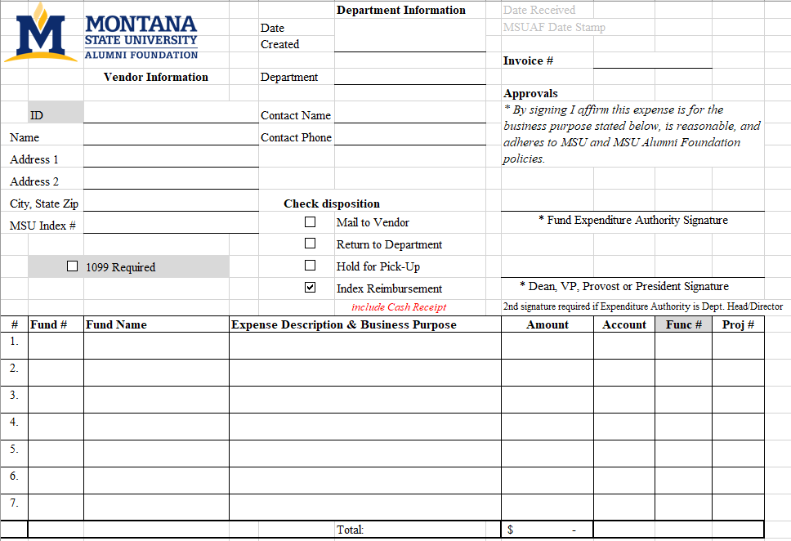

Slide 42
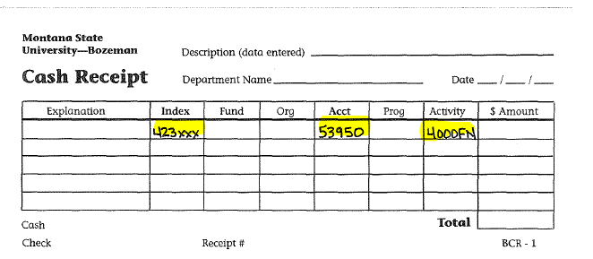

Slide 43
What happens next?
The Foundation will review your disbursement voucher and backup materials
The Foundation will cut one check payable to MSU for all reimbursements received and approved according to their processing schedule (checks cut twice per week normally, more often during year end), which will be delivered to the Cashiers in MT Hall, along with the submitted deposit slips
The Cashiers will post the check to the appropriate Banner index numbers/accounts
A copy of the deposit slip will be returned to the department

Slide 44
Month | Budget Office | Business Office
July | Fiscal Year End Rolls and Final Balances Determined | Close old fiscal year and open new fiscal year
August |  | Reclass ledger entries
September | Budget Adjustments can begin to be processed for new FY | Financial Statements
October |  | Financial Statements and LAD Audit
November |  | Unrelated Business Income (UBI) reports due to UBS from Depts.
December
January |  | Communicate negative cash concerns to departments (continues through spring)
February
March | All base adjustments must be completed
April | Salary Projections completed and distributed to departments | Capital Inventory review confirmation and report AND Minor/Sensitive Inventory reports due to Property Management
May | Budget Allocations Distributed and MSU Budget completed | Negative cash/fund balance review meetings-UBS, Budget Office, VPs and Directors
June | Budgets loaded and reviewed by depts for new year | Year End entries

Slide 45
UBS, UBO & Foundation Website Information
MSU Alumni Foundation >> Resources>> Resources for MSU partners
https://www.msuaf.org/s/1584/index.aspx?sid=1584&gid=1&pgid=3929
University Business Services Website
http://www.montana.edu/ubs/
University Business Procedures Manual (use NetID to log in)
http://www.montana.edu/policy/business_manual/
University Budget Office Website
www.montana.edu/budget

Slide 46
Important Contacts
Questions about Foundation reimbursements:
Carrie Faulhaber, Controller, 994-6421
Carrie.faulhaber@msuaf.org
Barb Gordon, Assistant Controller, 994-2508
Barb.Gordon@msuaf.org
Questions about Budgets:
Megan Lasso, Budget & Fiscal Manager, 994-1834
mbergstedt@montana.edu
Mackenzie Seeley, Budget Analyst, 994-2990
mackenzie.seeley@montana.edu
Questions about adding index/funds:
Tanya Arrington, UBS, Financial Manager, 994-3345
Tanya.Arrington@montana.edu
Other/General UBS questions:
Christina Fournier, UBS, Financial Manager, 994-3653
Fournier@montana.edu or UBSHelp@montana.edu

Slide 47
Questions & Comments

