Slide 1
Place Matters:
Review of the Literature on
Rural Teacher Education
Emilie Reagan, Elyse Hambacher, Tom Schram, Kathryn McCurdy, Dan Lord, Thomas Higginbotham, Beth Fornauf
International Symposium for Innovation in Rural Education
August, 2018

Slide 2

Teacher Residency for Rural Education (TRRE)
15-month residency program funded by five-year Teacher Quality Partnership grant
100% community-embedded master’s level program prepares teachers for high-need rural schools
Integrated school- and community clinical experiences
Graduates receive induction and professional development support for first two years of teaching
Graduates required to teach in rural high-need schools for three years

Slide 3
Reviews of Literature on Rural Education
DeYoung, 1987
Yarrow et al., 1999
Biddle & Azano, 2016

Slide 4
“Placing” Teachers
“All teachers eventually find themselves in a particular place.”
(Corbett, 2010, p. 83)

Slide 5
A Persistent Dilemma
Preparing teachers for somewhere
Preparing teachers for anywhere

Slide 6
A malleable and contested dialogue
Place as a pedagogical construct
Rurality as a cultural construct

Slide 7
Research Questions
What does the literature say about the recruitment, preparation, support, and retention of teachers for rural places?
How, and to what end, does the research posit “place” as a priority and/or focus of inquiry for research in rural teacher education?
How does the research conceptualize the limits, challenges, opportunities, and complexities of “rural” as a context for teacher preparation?
What does empirical research reveal about the preparation, support, recruitment and retention of teachers for rural places?

Slide 8
Methods
Databases & Journals
ERIC
Journal of Research on Rural Education
Rural Educator
Rural Special Education Quarterly
Criteria for Inclusion
Peer-reviewed publication
Published between 2007 – 2017
Field of teacher education
Focus on rural schools and/or communities

Slide 9
Overview:
97 Publications

Slide 10
Overview:
97 Publications

Slide 11
Findings
Conceptualizing Place in Rural Teacher Education
Investigating Place: Empirical Review of Rural Teacher Education

Slide 12
How Place Serves to Frame and Prioritize Research
Focus of research | Definition of rural space | Teacher identity | Intended effect on rural teacher education
Problem-focused, issues of rural teacher recruitment and retention | Overall description of rural teaching context | Broad rural expertise | Increased awareness of common issues facing rural teachers
Rural school practicum and experiences | General rural orientation, but grounded in specific rural experiences | Shifting identity toward rural places | Dispelling myths and stereotypes while increasing familiarity with rural teaching
Place-conscious paradigm for rural teaching | Contested and complex rurality; focused on getting to know specific places | Place-conscious and open to change due to diverse local understandings | Place-building, sustainable and vibrant rural futures; inclusive of diverse rural learners

Slide 13
Place and Research Focus
Focus of research | Definition of rural space | Teacher identity | Intended effect on rural teacher education
Problem-focused, issues of rural teacher recruitment and retention | Overall description of rural teaching context | Broad rural expertise | Increased awareness of common issues facing rural teachers
Rural school practicum and experiences | General rural orientation, but grounded in specific rural experiences | Shifting identity toward rural places | Dispelling myths and stereotypes while increasing familiarity with rural teaching
Place-conscious paradigm for rural teaching | Contested and complex rurality; focused on getting to know specific places | Place-conscious and open to change due to diverse local understandings | Place-building, sustainable and vibrant rural futures; inclusive of diverse rural learners

Slide 14
Place-Conscious Paradigm
Focus of research | Definition of rural space | Teacher identity | Intended effect on rural teacher education
Place-conscious paradigm for rural teaching | Contested and complex rurality; focused on getting to know specific places | Place-conscious and open to change due to diverse local understandings | Place-building, sustainable and vibrant rural futures; inclusive of diverse rural learners

Slide 15
“Positionality” in Rural Teacher Education
Moving beyond insider/outsider dichotomies
Developing rural social and cultural capital
Finding one’s place as a teacher and community member
Shifting identities
What does it mean to teach with a place-conscious identity?
Place-building and rural sustainability
Creating pedagogies and goals that fit specific rural places

Slide 16
Findings
Conceptualizing Place in Rural Teacher Education
Investigating Place: Empirical Review of Rural Teacher Education

Slide 17
Investigating Place:
Empirical Review
Majority of studies reported on isolated contexts (e.g., a particular course or a particular field experience)
Some studies reported on longer-term initiatives (e.g., Australia, China)

Slide 18
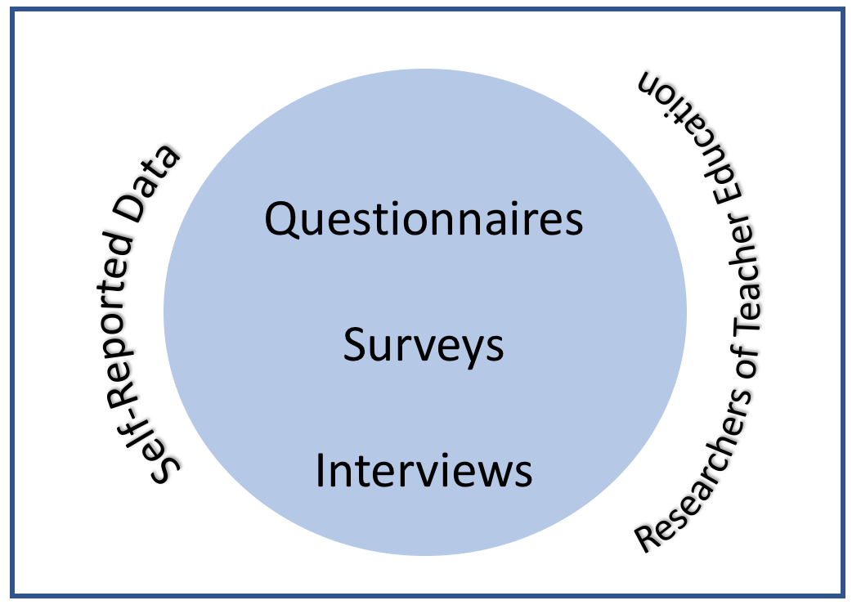
Investigating Place:
Empirical Review

Slide 19
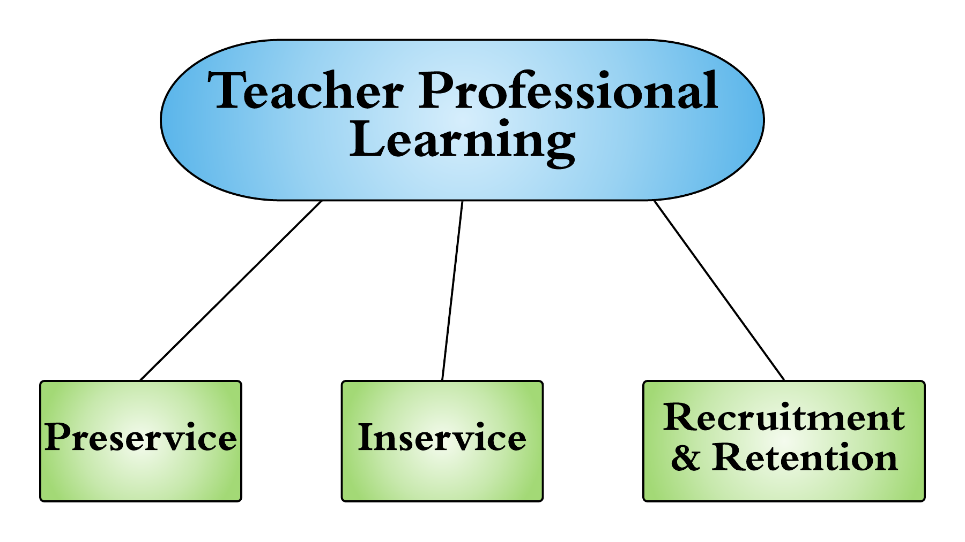
Investigating Place:
Empirical Review

Slide 20
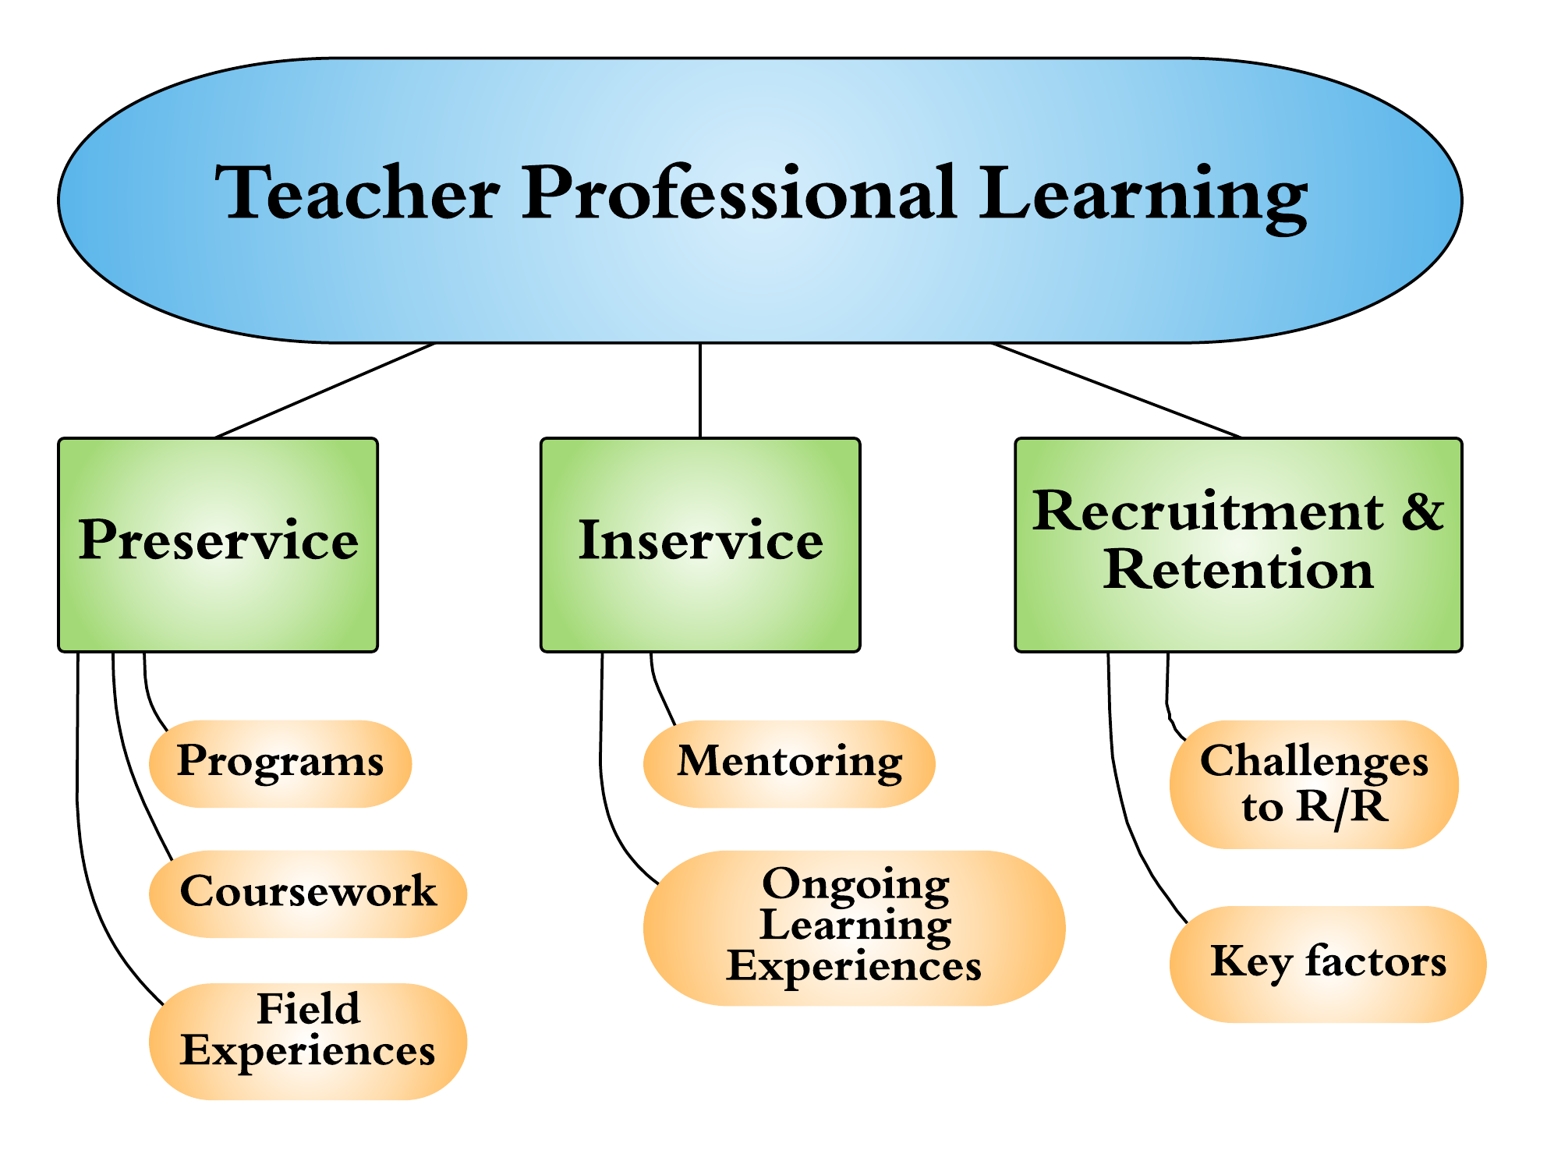
Investigating Place:
Empirical Review

Slide 21
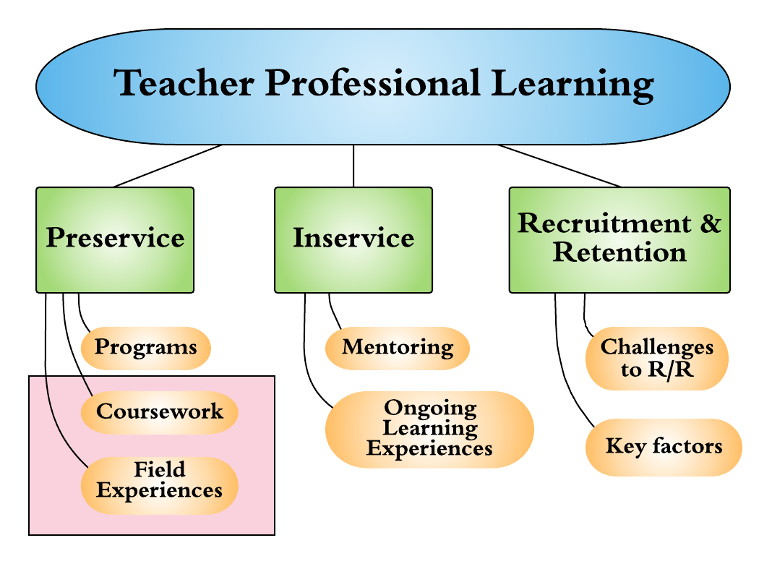
Investigating Place:
Empirical Review

Slide 22
Preservice Teacher Learning
Raise an awareness and appreciation for rural contexts
Shift deficit perspectives to asset-based understandings
Promote an interest to teach in rural communities
Example: Azano & Stewart (2015)

Slide 23
Discussion & Implications
Conceptualizing Place
Operationalizing Place
Preparing and supporting community teachers and researchers
Investigating Place
Researching rural teacher education through national, longitudinal efforts
Foregrounding place in teaching and scholarship

Slide 24
Why Place Matters
“To know how to teach is to know a great deal about where you are teaching and the conditions experienced by the people in that place. This involves an immersion in the culture, of the place, its history, the way power is exercised there, how resources are distributed, and the way school has been experienced historically in the community by different kinds of families.” – Corbett, 2010

Slide 25
Place Matters:
Review of the Literature on
Rural Teacher Education
Emilie Reagan, Beth Fornauf, Elyse Hambacher, Thomas Higginbotham, Dan Lord, Kathryn McCurdy, Tom Schram
International Symposium for Innovation in Rural Education
August, 2018

