Slide 1
Growing Success: The Need for Rural Schools to Collaboratively Succession Plan to Grow and Sustain Their Leadership Pipeline August 2, 2018
Dr. Lora Wolff
Western Illinois University, ll-wolff@wiu.edu
Michaela Fray
Regional Office of Education #1, mfray@roe1.net

Slide 2
IL-PART GRANT
Illinois Partnerships Advancing Rigorous Training
Illinois Principal Preparation Redesign
Required by All Programs 2014
“Prepare individuals to be highly effective in leadership roles to improve teaching and learning and increase academic achievement and the development of all students.”
Notes:
3 minutes.
Brief Background on the IL-PART Grant
Is a federally funded project, represents a collaborative effort between high-need districts and universities to form partnerships aimed at transforming leadership preparation and development using a collaborative model

Slide 3
The Principalship: Just the Facts
93,000 principalships nationwide
42% turnover rate in elementary principals
Principal Applicants—
1970: 40 applicants
2000: 10 applicants
National Association for Elementary School Principals
58% of elementary principals said compensation was insufficient for responsibilities
25% of elementary principals said too much time is required for the job
23% of elementary principals said the position was too stressful

Slide 4
Issues with the Principalship
Time:
54-80 hours/week
Too much on plate
Society problems
Work Related Stress:
Meeting student achievement standards
Special education requirements
School funding
Institutional Interference:
Difficulty removing poor teachers
Negotiated agreements
Central office interference
Salary:
Little financial incentive
Inadequate pay
Source: Suzette Lovely, Staffing the Principalship

Slide 5
Salaries of the Principalship
LEVEL | Urban/Suburbs |  | Rural
 | High | Average | High | Average
Elementary | 184,215 | 112,435 | 120,601 | 68,457
Middle School | 183,771 | 119,054 | 109,195 | 83,627
High School | 238,007 | 129,717 | 115,584 | 78,099
In every instance, rural principals are lower than urban/suburban salaries.
Gap is over $110,000 for the highest paid high school principals (U/S vs Rural).
Gap exists in average salaries (Range of Gap: $35,000 to $51,600).
Source: Illinois State Board of Education (ISBE); 2017-18 Illinois Principals’ Salaries

Slide 6
One Solution…Grow Your Own
Source: Whitaker and Barnett (1999)

Slide 7
Project Goals
Goal 1: Prepare highly-effective school principals and assistant principals that positively impact student learning in high-need districts
Goal 2: Develop effective partnerships between university partners and high-need districts to build leadership capacity in an effort to improve student outcomes.
Goal 3: Dissemination of IL-PART evaluation findings and emerging best practices in principal preparation and partnership development

Slide 8
IL-PART Theory of Action
Illinois State Legislation on Principal Preparation
Schools Demonstrate Positive Change(s) via Working Conditions and Student Growth Gains (outcome)
Partnership Advisory Committee
University-–District Partnerships
Principal and APs* Retained for at Least 2 Years (outcome)
Selection of High-Potential Candidates
School-Based Learning Experiences (Internships)
Performance-Based Assessments
Principal Certification Earned**
Principals and APs Placed in High-Need Schools (outcome)
Pool of Highly Effective Principals and APs for High-Need Schools in the State or Region
Alignment of assessments with district principal evaluation system
Assessments used to match potential principals with high-need schools
Extensive teaching experience
Knowledge and Skills
Portfolio of accomplishments (including evidence of student growth and leadership)
Training for faculty supervisors
Training for district mentors
Network and development opportunities
Data sharing and analysis
Note: Orange lines represent the influence or introduction of state or local policies and organizational requirements. Black lines show the route of impact of the participating stakeholders or the anticipated outcomes of the larger IL-PART project. Light blue lines indicate the set of activities that are jointly administered by the university-district partnerships. * AP = assistant principals. ** Principal certification is done jointly by ISBE and the respective university or college: (1) the college or university recommends an individual for certification to IBSE upon successful completion of principal preparation coursework and requirements, (2) ISBE administers a certification exam to the individual, and (3) upon passing the individual is awarded the new Principal Endorsement.
Notes:
Our focus: what does it look like on the ground? We are working it/implementing it and AIR is studying it along the way
What does this look like in action?
Importance of TIME- it takes time to develop relationships
Research is important but the pragmatic piece is too

Slide 9
Partners and Partnerships

Slide 10
Evaluating the Internship

Slide 11
RQ1: Implementation and Recruitment

Slide 12
RQ2: Satisfaction With Internship Preparation
Both traditional yearlong and intensive internship candidates reported that they were well-matched with their mentor principals on a variety of factors important to them.
Both intensive and traditional yearlong internship candidates report that they were well-matched with their internship sites.
Traditional yearlong internship candidates reported that they were less likely to be supervised than their intensive internship counterparts.

Slide 13
Mentor Principal Perspectives: Candidates Participation in Internship Experiences (n = 20)

Slide 14
Faculty Supervisor Perspective: Candidates Participation in Internship Experiences (n = 8)

Slide 15
Traditional Yearlong Candidate Internship Activities (n =17)

Slide 16
Mentor Principal Matching
Full-Time, Full-Semester Respondents (n = 5)
Traditional Yearlong Candidates (N = 17)

Slide 17
Internship Matching
Full-Time, Full-Semester Respondents (n = 5)
Traditional Yearlong Respondents (n = 17)

Slide 18
Experience With Mentor Principal Supervision
Full-Time, Full-Semester Candidate Perspectives (n = 5)
Traditional Yearlong Candidate Perspectives (n = 17)

Slide 19
Replicating the Work

Slide 20
Full Time Internship Model
IL-Part has piloted an intensive full time/full semester internship model.
The intensive model provides a longer duration of full-time, job embedded experiences than a traditional internship allows.
The intensive model’s approach to funding the substitute is a cost effective and replicable strategy.
Project covers the substitute teacher’s cost, versus the salary cost of the principal intern.

Slide 21
Calculating the Costs

Slide 22
Questions to Consider When Calculating the Costs

Slide 23
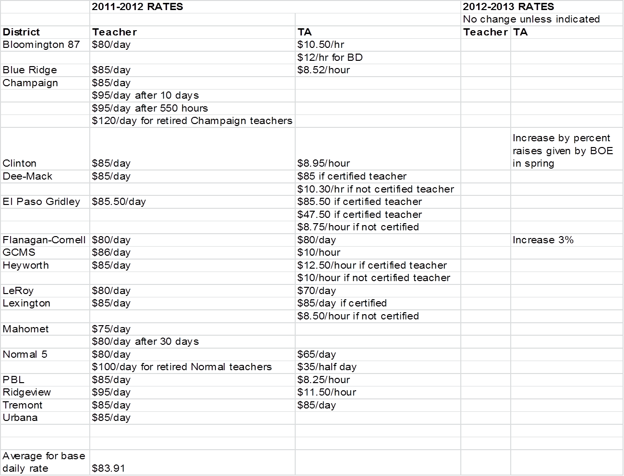

Slide 24
Practical Lessons Learned
The Affordable Care Act and how this affects substitute teacher benefits
New teacher evaluation requirements and aligning the full-semester internship during off-year teacher evaluation cycles
Identification and placement of quality substitute teachers to avoid negative impact on student learning
Retaining candidates in the district after the internship
Utilizing this model for successful succession planning to sustain the principal pipeline

Slide 25
Growing Success: Growing Your Own Reprise
Of the full-time internship in the Quincy Public Schools/Western Illinois Partnership:
1 is an elementary principal in a neighboring rural district (elementary)
1 chose to continue in the classroom and will not pursue a principalship (didn’t complete all components of internship)
1 is continuing as a teacher in the district and looks to move into an administrative position
1 is the activities director in the Quincy District
1 is a SAM (School Administrative Manager) in the building she interned
1 is the Director of the Regional Vocational School (equivalent of a principal)
1 moved to another rural district

Slide 26
IL-PART Web Site: www.ilpart.org
Dr. Lora Wolff
Western Illinois University, ll-wolff@wiu.edu
Michaela Fray
Regional Office of Education #1, mfray@roe1.net

Slide 27
Questions?

Slide 28
Follow the Work
IL-PART Web Site
www.ilpart.org
Leading Education Partnerships
https://leadingedpartnerships.org/
Center for the Study of Education Policy
http://education.illinoisstate.edu/csep/
CSEP_ISU
https://www.facebook.com/ISU.CSEP
Illinois School Leader
www.illinoisschoolleader.org

Slide 29
IL-PART Evaluation
1. To what degree has the Illinois Partnerships Advancing Rigorous Training (IL-PART) been implemented as planned across participating university and college partners, and why have there been changes to the implementation plan? (Process Evaluation)
2. How does principal satisfaction with participation in full-time, full-semester preservice internships compare with traditional yearlong internships? (Process Evaluation)
3. To what degree do candidates who completed the full-time, full-semester preservice internships seek and get positions as principals in high-need or low-performing schools in comparison with candidates who completed traditional yearlong internships? (Impact Evaluation)

Slide 30
IL-PART Evaluation
4. How does preservice principal skill development (e.g., instructional leadership skills measured by the certification examination) compare between participants from the two internship models? (Impact Evaluation)
5. How, if at all, has student learning changed in schools led by candidates who completed full-time, full-semester internships in comparison with student learning in similar schools led by candidates who completed traditional yearlong internships? (Impact Evaluation)

Slide 31
Frequency of Observations
Full-Time, Full-Semester Candidates (n = 5)
Traditional Yearlong Candidates (n = 17)

Slide 32
Number of Formal Mentor Principal Observations: Full-Time, Full Semester Candidates (n = 4) and Traditional Yearlong Candidates (n = 9)

Slide 33
Next Steps
RQ4. How does preservice principal skill development (e.g., instructional leadership skills measured by the certification examination) compare between participants from the two internship models? (Impact Evaluation)
RQ5. How, if at all, has student learning changed in schools led by candidates who completed full-time, full-semester internships in comparison with student learning in similar schools led by candidates who completed traditional yearlong internships? (Impact Evaluation)

